Slide 1
25 Negotiation Styles around The World
Language is only the most obvious part of the global communication gap. Different cultures also have distinct approaches to communication during meetings, as described by British linguist Richard D. Lewis, whose best-selling book, “When Cultures Collide,” charts these as well as leadership styles and cultural identities.
Lewis, who speaks ten languages, acknowledges the danger of cultural comparisons in his book: “Determining national characteristics is treading a minefield of inaccurate assessment and surprising exception. There is, however, such a thing as a national norm.”
In support of cross-cultural studies, he writes: “By focusing on the cultural roots of national behaviour, both in society and business, we can foresee and calculate with a surprising degree of accuracy how others will react to our plans for them, and we can make certain assumptions as to how they will approach us. A working knowledge of the basic traits of other cultures (as well as our own) will minimize unpleasant surprises (culture shock), give us insights in advance, and enable us to interact successfully with nationalities with whom we previously had difficulty.”
Lewis’ diagrams show how cultures use language to communicate during meetings, with wider shapes showing greater conversational range, obstacles marked in grey, and cultural traits noted as well.
We’ll go over the rest in brief after a selection of charts taken with permission from the 2005 third edition of “When Cultures Collide.” (Click to enlarge.)

Slide 2
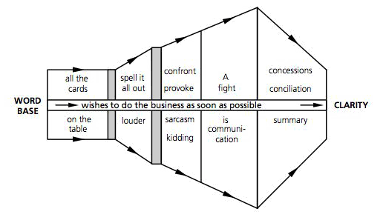
American
Americans, tend to launch right into negotiations, respond to discord confrontationally, and resolve with one or both sides making concessions.

Slide 3
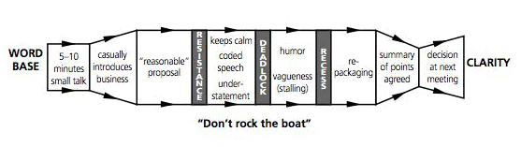
English
English tend to avoid confrontation in an understated, mannered, and humorous style that can be both inefficient and powerful.

Slide 4
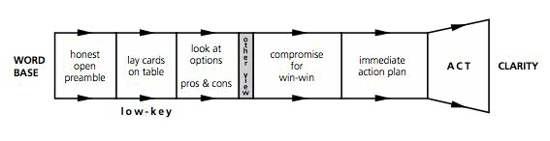
Canadian
Canadians tend to be more low-key and inclined to seek harmony, though they are similarly direct.

Slide 5
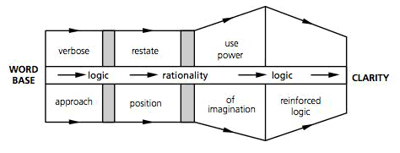
French
French tend to engage vigorously in a logical debate.

Slide 6
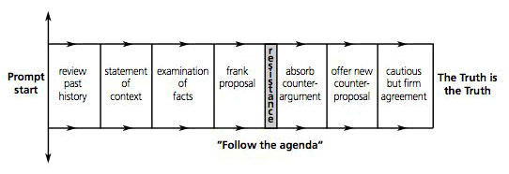
German
Germans rely on logic but “tend to amass more evidence and labour their points more than either the British or the French.”

Slide 7
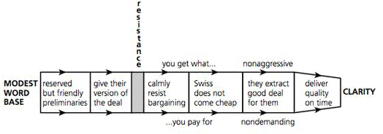
Swiss
Swiss tend to be straightforward and unaggressive negotiators, who obtain concessions by expressing confidence in the quality and value of their goods and services.

Slide 8
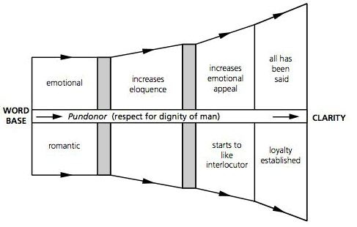
Spanish
Spanish and Italians “regard their languages as instruments of eloquence and they will go up and down the scale at will, pulling out every stop if need be to achieve greater expressiveness.”

Slide 9
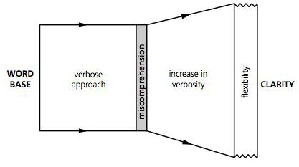
Italian

Slide 10
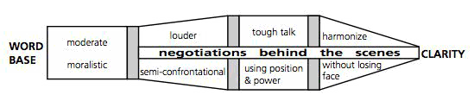
Chinese
Chinese tend to be more direct than the Japanese and some other East Asians; however, meetings are principally for information gathering, with the real decisions made elsewhere.

Slide 11
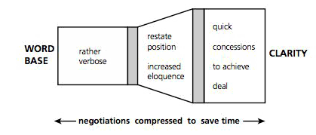
Hong Konger
Hong Kongers negotiate much more briskly to achieve quick results.

Slide 12
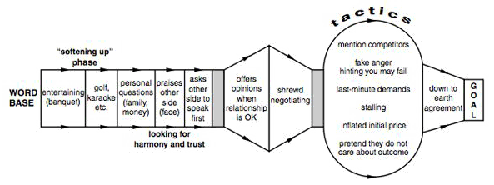
Singaporean
Singaporeans generally take time to build a relationship, after which they can be shrewd negotiators.

Slide 13
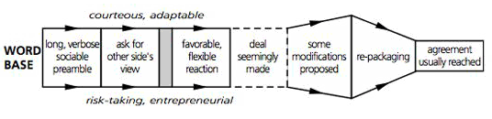
Indian
Indian English “excels in ambiguity, and such things as truth and appearances are often subject to negotiation.”

Slide 14
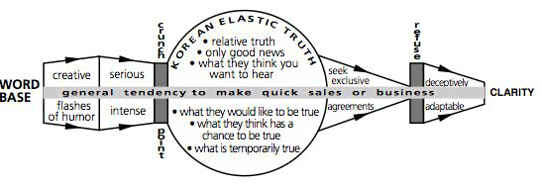
Korean
Koreans tend to be energetic conversationalists who seek to close deals quickly, occasionally stretching the truth.

Slide 15
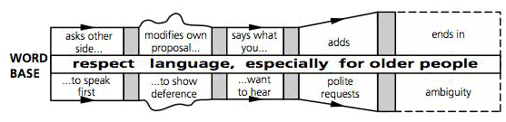
Indonesian
Indonesians tend to be very deferential conversationalists, sometimes to the point of ambiguity.

Slide 16
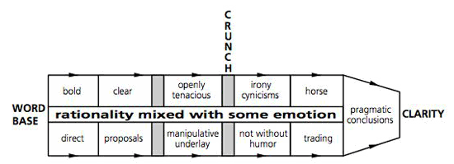
Israeli
Israelis tend to proceed logically on most issues but emotionally on some.

Slide 17
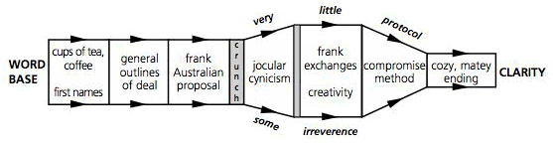
Australian
Australians tend to have a loose and frank conversational style.

Slide 18
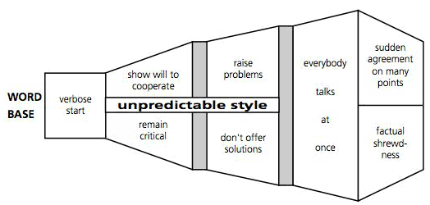
Hungarian
Hungarians value eloquence over logic and are unafraid to talk over each other.

Slide 19
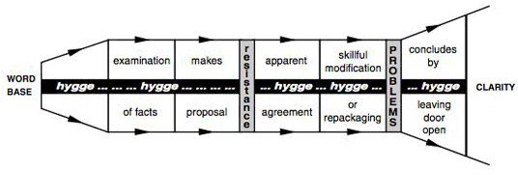
Danish
Scandinavians often have entrenched opinions that they have formulated “in the long dark nights,” though they are reasonable conversationalists.

Slide 20
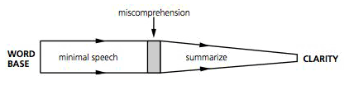
Finnish
Finnish tend to value concision.

Slide 21
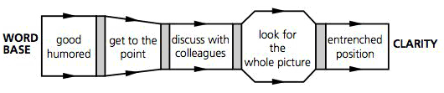
Norwegian
And most Norwegians fall somewhere in between.

Slide 22
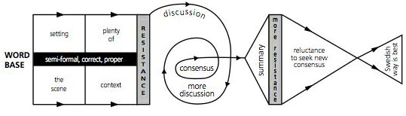
Swedish
Swedes often have the most wide-ranging discussions.

Slide 23
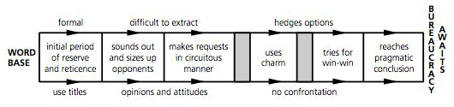
Bulgarians
Bulgarians may take a circuitous approach to negotiations before seeking a mutually beneficial resolution, which will often be screwed up by bureaucracy.

Slide 24
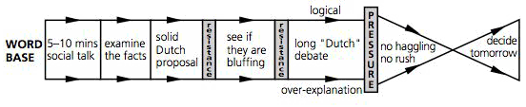
Dutch
The Dutch are focused on facts and figures but “are also great talkers and rarely make final decisions without a long ‘Dutch’ debate, sometimes approaching the danger zone of over analysis.”

Slide 25
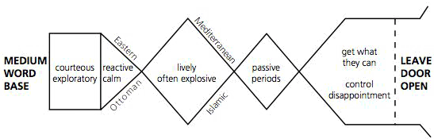
Turkish

Slide 26
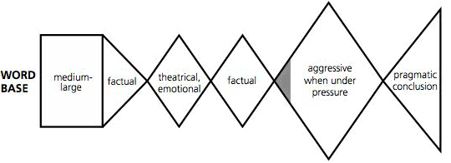
Polish
Poles often have a communication style that is “enigmatic, ranging from a matter-of-fact pragmatic style to a wordy, sentimental, romantic approach to any given subject.”

Slide 27
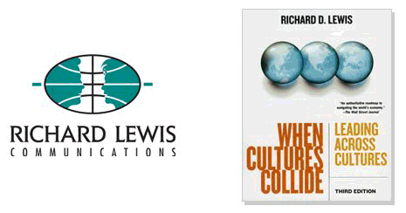
25 Negotiation Styles around The World

